Slide 1
Reporting statistics

Slide 2
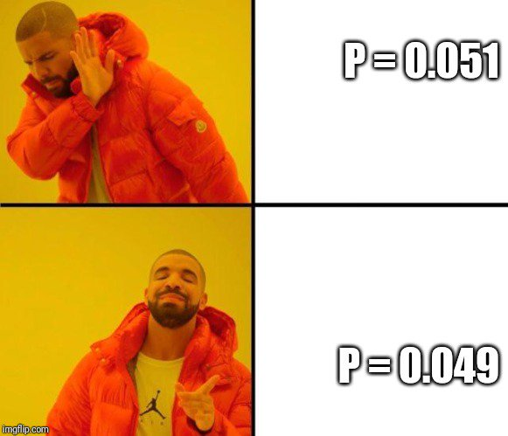
What is P?

Slide 3
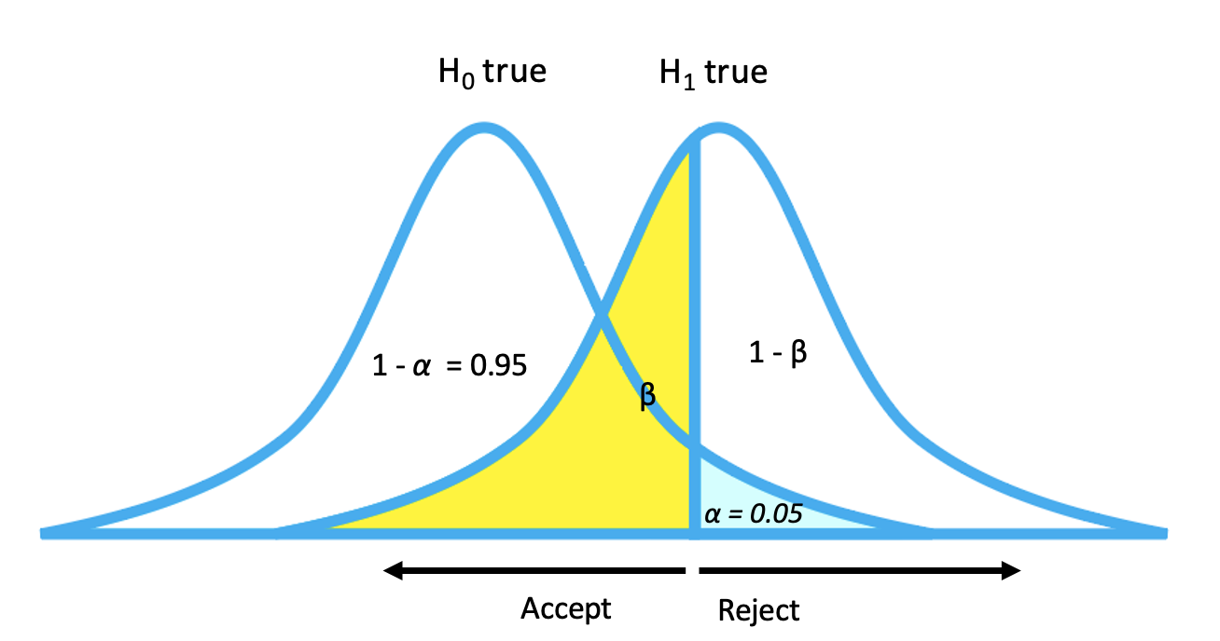
What is P?
P = the probability of getting results at least as extreme as the current results, but due to chance.
Sample size
Expected outliers
Expected degree of differentiation between null and alternative outcomes
P is useless to guide decisions without alpha

Slide 4
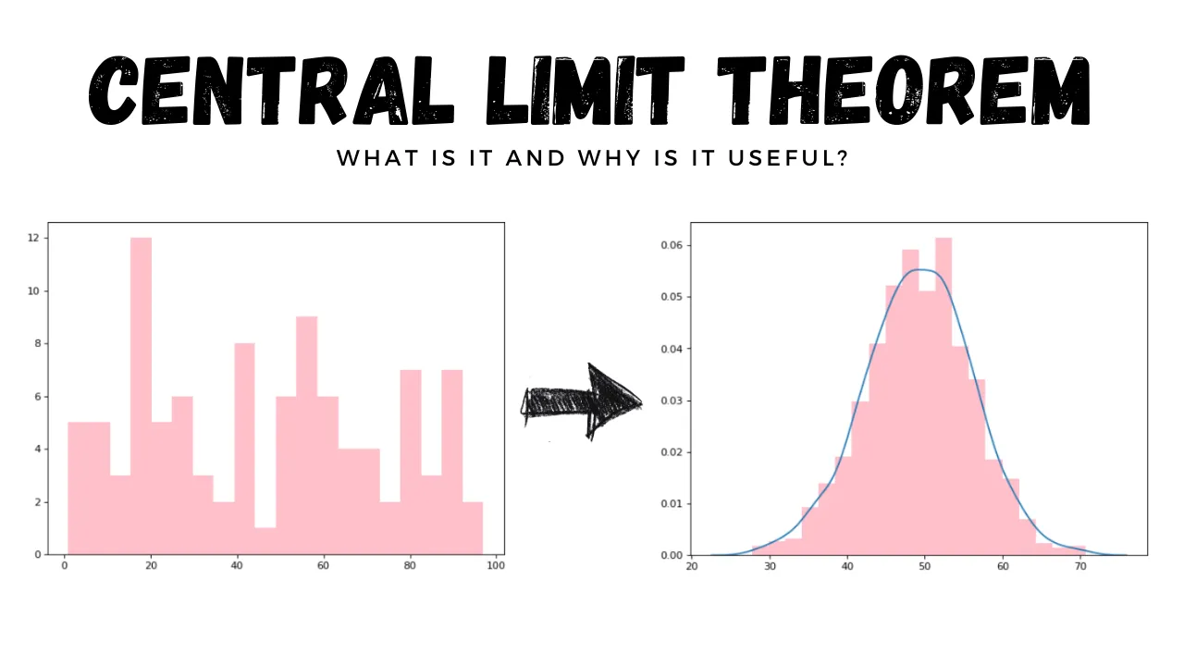
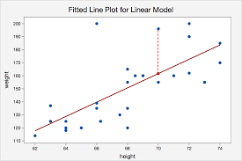
What are we interested in testing with P?
Slopes
Differences in means
“Furthermore, the central limit theorem implies that for large samples the sampling distribution of the parameters will be at least approximately normal, even if the distribution of the errors is not. Hence, the regression model is robust with respect to violations of the normality assumption.”

Slide 5
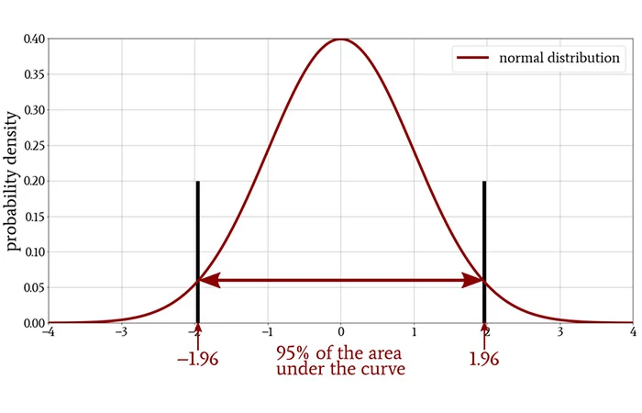
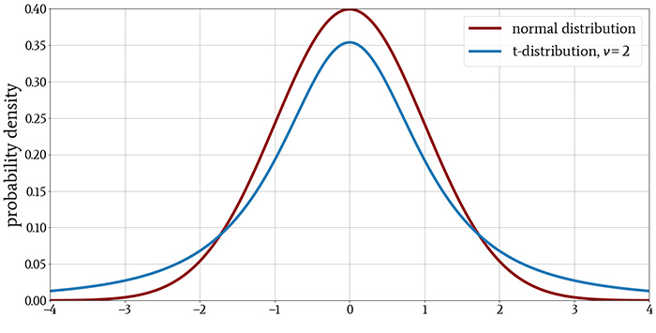
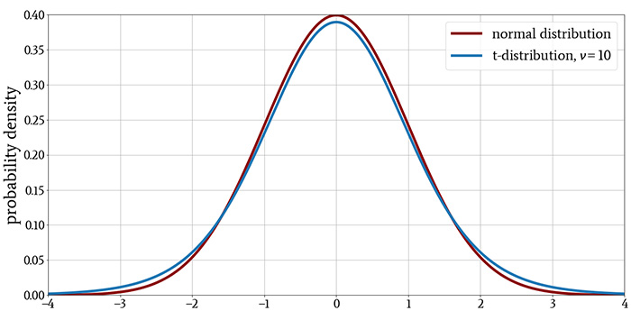
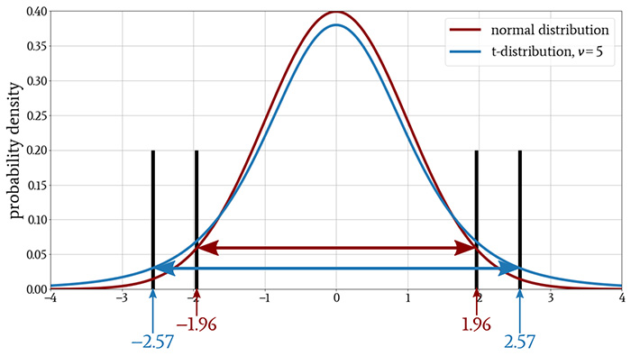
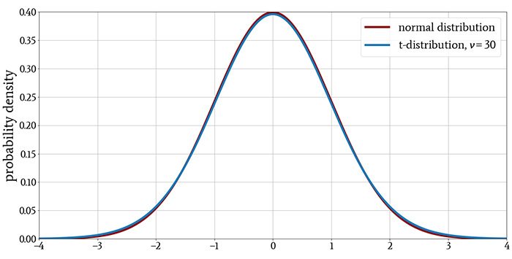
Statistics
The t-distribution is often used to calculate significance of a difference in means or a slope (Null = 0). t
t = number of standard deviations of the t distribution that contain 95% of the values (alpha = 0.05)
t puts more weight on the tails as sample size decreases
DF = n-1 (the last obs is not ‘free’ because it can be achieved by knowing the parameter and all the other data)
Using t rather than the normal distribution helps correct for outliers when samples are small (use z for larger samples)

Slide 6
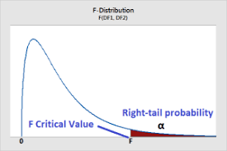
Statistics
F is a ratio that can be used to compare any two distributions
In regression, F = variance explained by your factor of interest / variance not explained by the factor of interest
When reporting F, you need to provide 2 degrees of freedom
Numerator DF = number of factor levels in your variable – 1
Denominator DF = Total observations – number of factors
(As your number of levels increases, your statistical power goes down)
Critical value of F depends on DF and alpha

Slide 7
Statistics – model evaluation
R² = fraction of overall variance in the data explained by your model (0-1)
This can be adjusted for number of factors/factor levels ot facilitate comparison across models
Can also be compared across different types of predictors in your moldes - main factors of interest only [marginal R²]
- main factors plus controlling covariates [conditional R²]

Slide 8
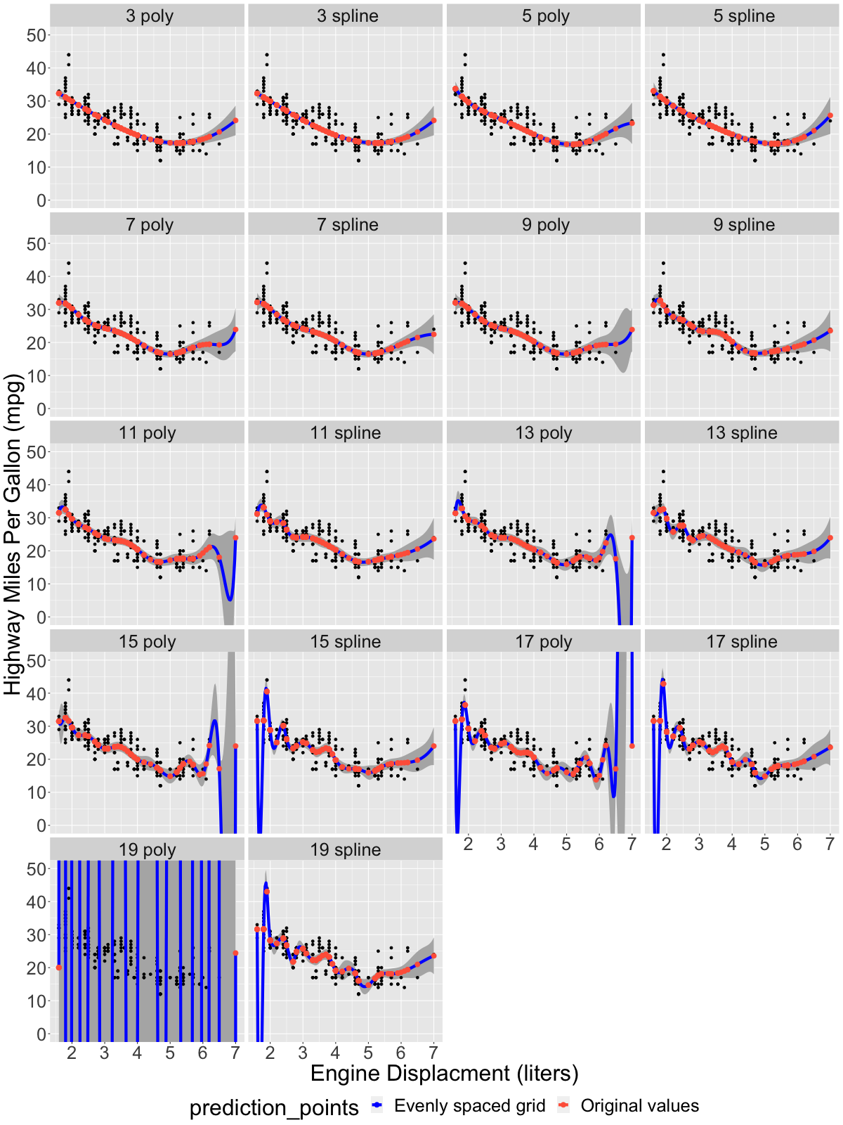
Statistics – model evaluation
AIC (Akaike Information Criterion) family of metrics
Lower is better
Optimises balance between underfitting (too much unexplained variation) vs. overfitting (too much explained variation, predictive power diminished

Slide 9
What do you need to report?
Effect size / difference between means (standardize??)
Standard error (= standard deviation in the residuals around your estimate or sample means, corrected for sample size) OR confidence intervals (interval in which 95% of your data is represented)
The sample size or degrees of freedom
The threshold selected for statistical significance
The test statistic (depending on question: IS there an effect? vs. WHAT is the effect?)
Depending on question: overall model fit / comparison (R², AIC…)

Slide 10
What do you need to report?
All the tests you conducted, and how you decided which ones to report
Thorough description of analytical methods, cite all software and packages used to generate statistical analyses and figures
Limit the reported analyses to ones needed to understand the data or evaluate the hypotheses

Slide 11
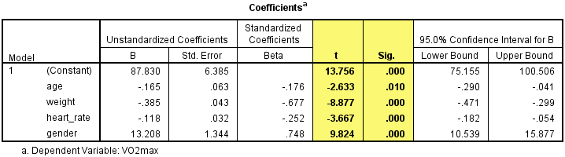
Some examples

Slide 12
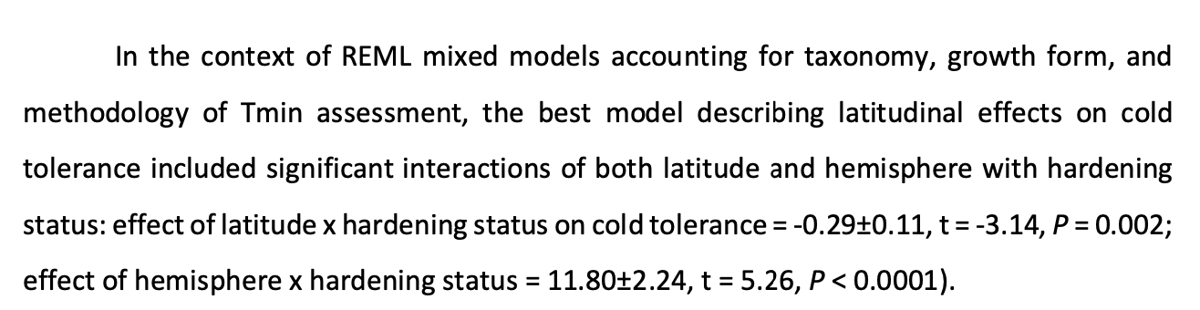
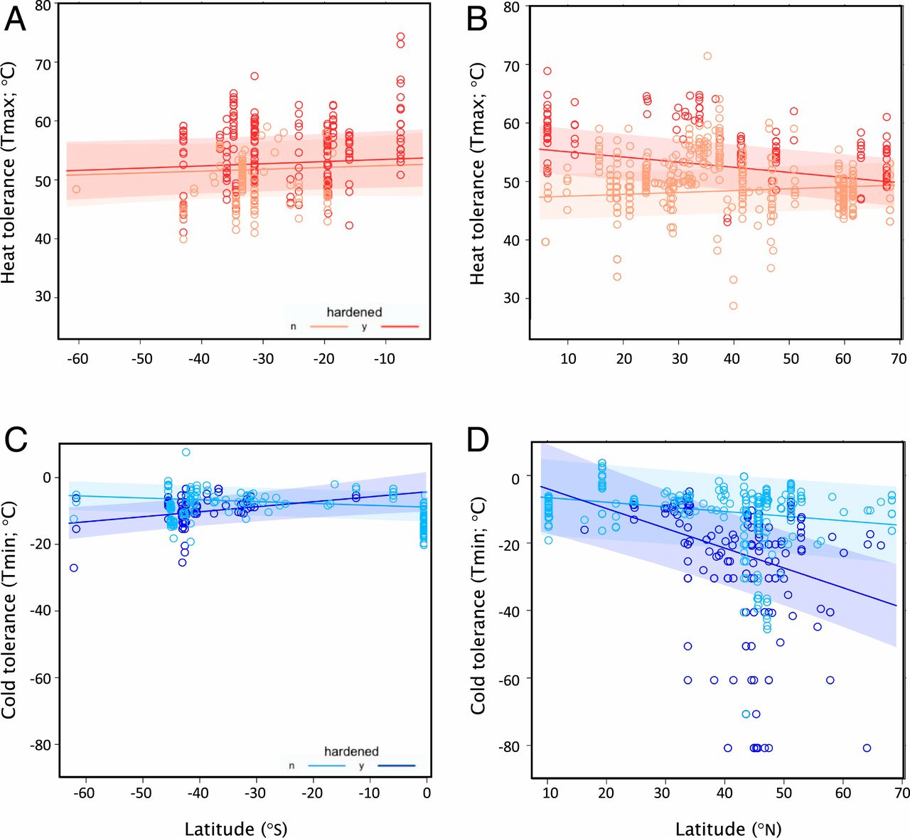
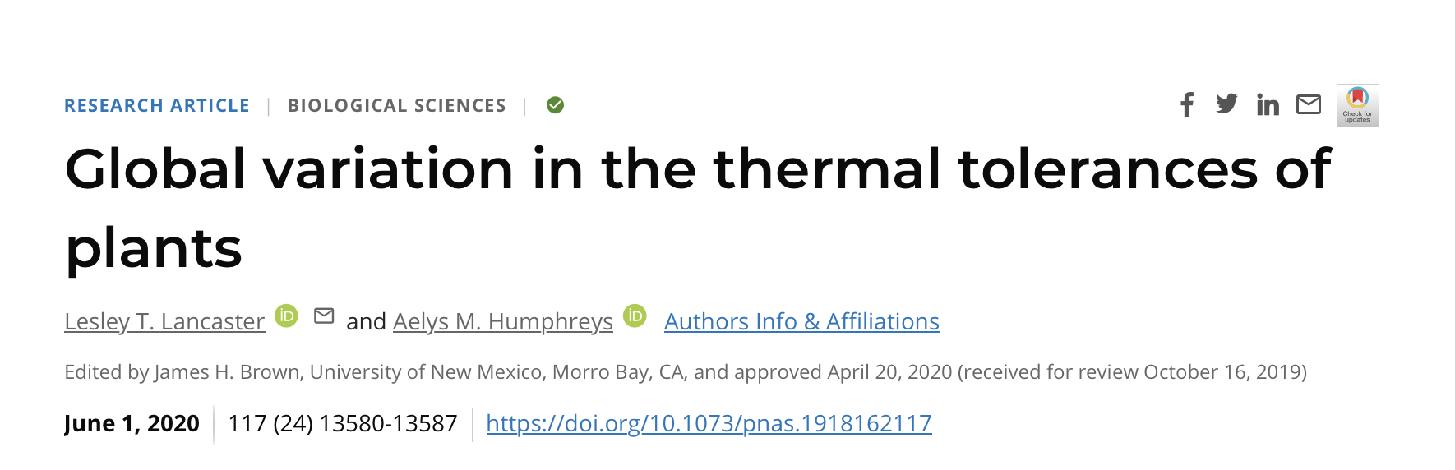
Some examples

Slide 13
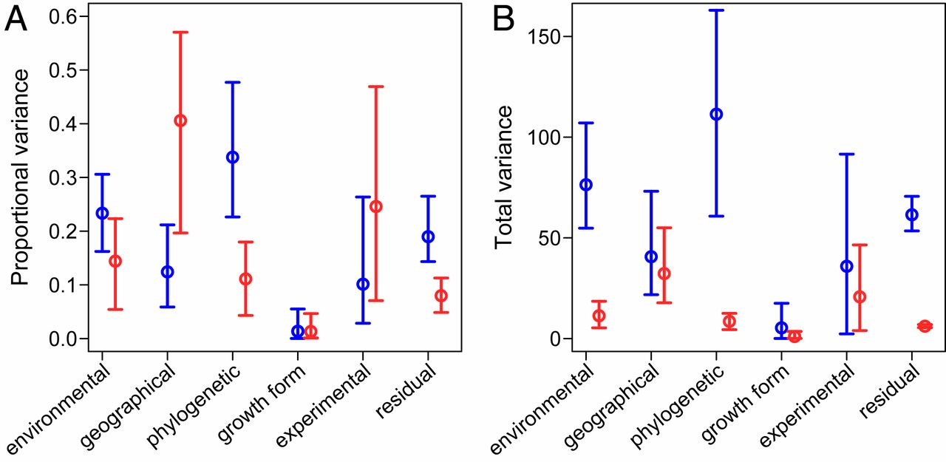
Some examples

Slide 14
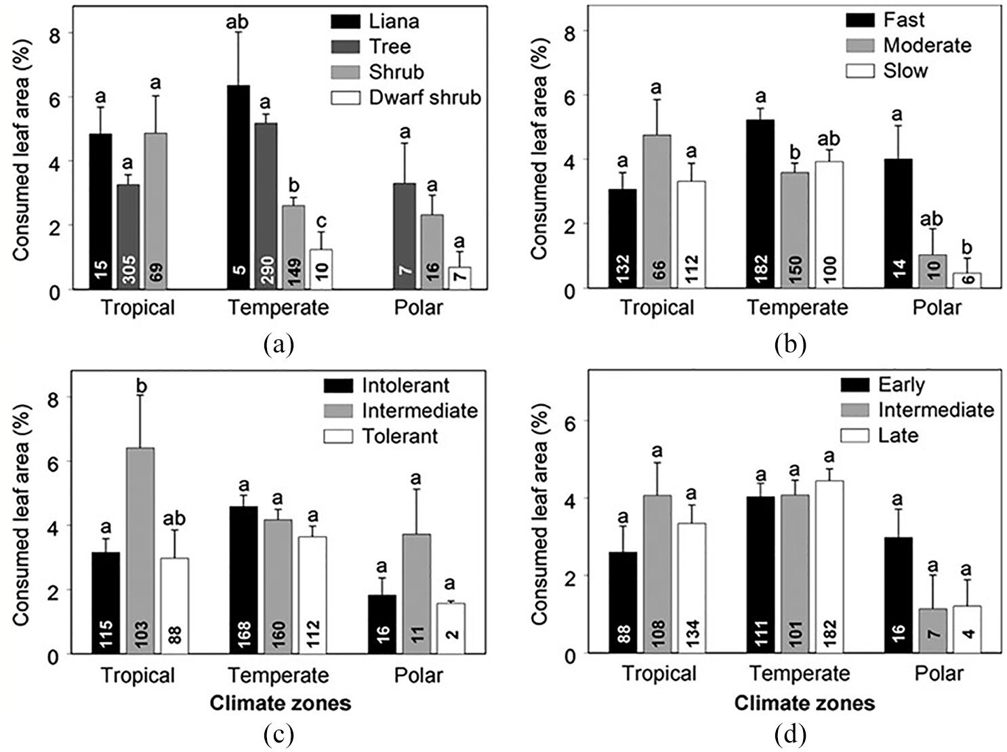
Using figures to depict complex outputs

Slide 15
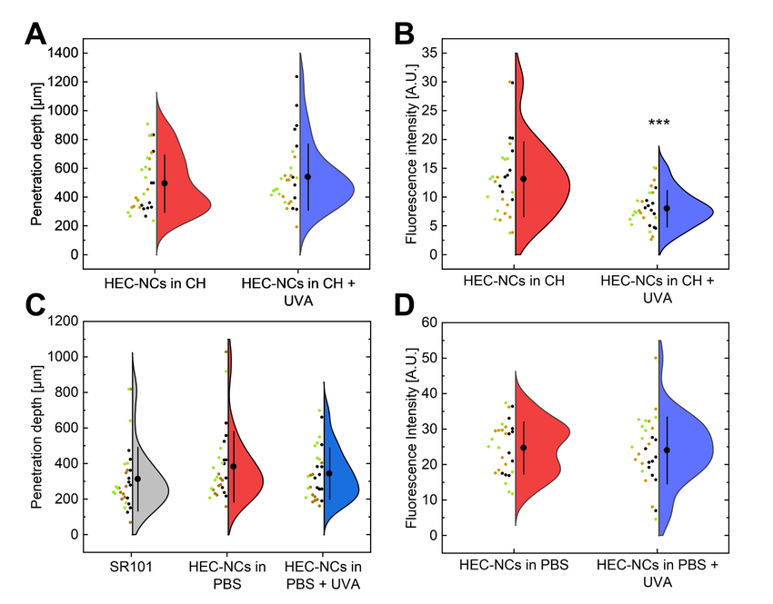
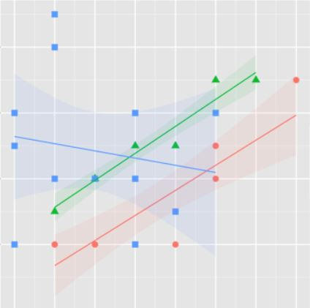
Showing raw data is always better; helps editors and peers evaluate the fit of your models
Do not neglect figure legends! Explain what statistical parameters all these plotted elements refer to !

Slide 16
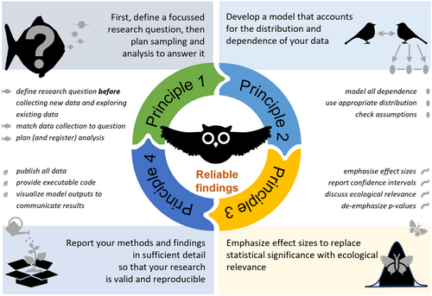
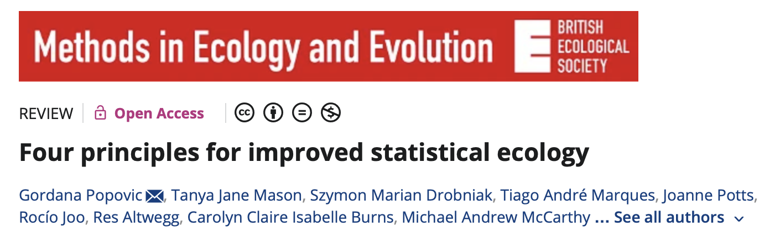
Statistical reporting should follow from hypothesis development and experimental design
YOU make the decisions

Slide 17
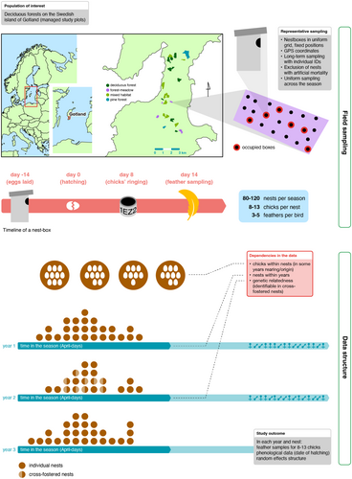
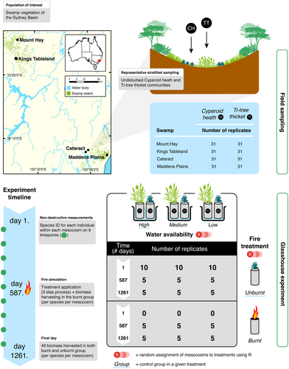
Some nice experimental design figures from the paper introduced on the previous slide

Slide 18
Best practice
Hypotheses, analysis methods, and results should read in parallel
Hypothesis 1
Hypothesis 2…
Test 1 (To test the hypothesis that… we…)
Test 2…
Result 1 (In the context of a xx type of model that controlled for yyy… we found…
Result 2…

Slide 19
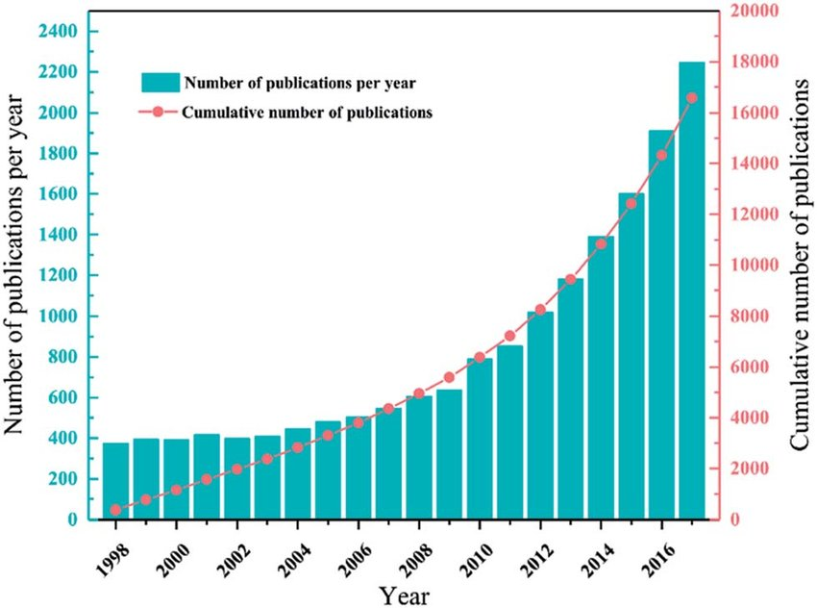



Best practice
Attention spans are diminishing as publication rates go up…
X

Slide 20
Further resources
https://www.esa.org/wp-content/uploads/2022/05/ESA-Statistical-Analysis-Guidelines.pdf

Slide 21

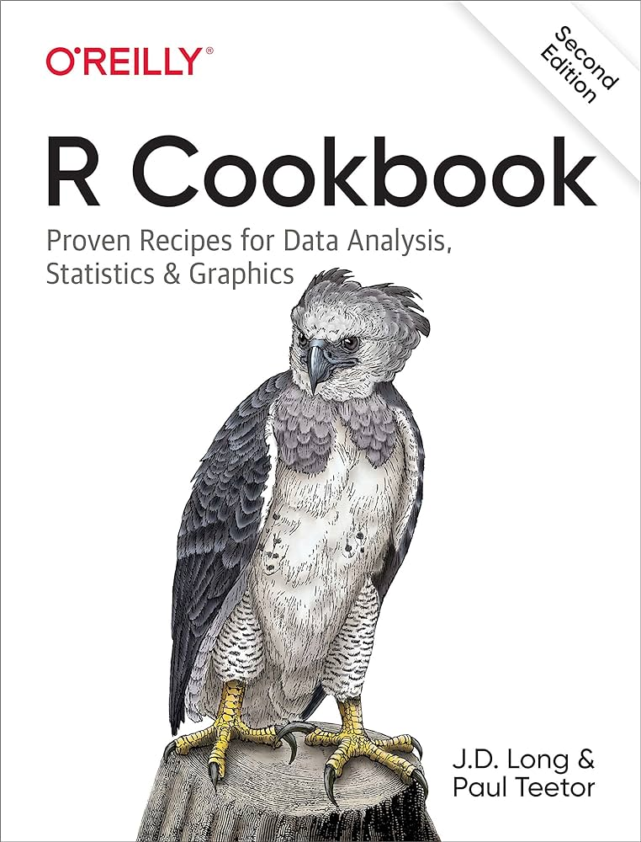


Final thoughts
Like cooking, statistics is both and art and a science. Find your style to produce your best results

